Slide 1

Jams Delay Clustering
This report was created to fulfil Mini Project Data Scientist in the Data Science Learning Studio Bootcamp 2023
Reported by Ayub Indra

Slide 2


Project Overview
Background
Bogor as one of the connecting cities of West Java and DKI Jakarta is one of the cities with dense traffic in Indonesia, it is undeniable that traffic jams can have an impact on environmental economic factors.
Project Goals
As a stakeholder, the Bogor city government needs a modelling in the form of road clustering to be able to find out which streets have the potential for high traffic jams to be able to make a traffic engineering strategy in order to expedite jams traffic.

Slide 3
Data Understanding
To solve the problem, a dataset from satellite navigation software on smartphones (Waze) is provided. The dataset has three types of data:
Jams: Traffic jam data based on current condition
Irregularities: Street data based on historical data
Alerts: Flags to indicate whether a special occasions occur or not on a street

Slide 4
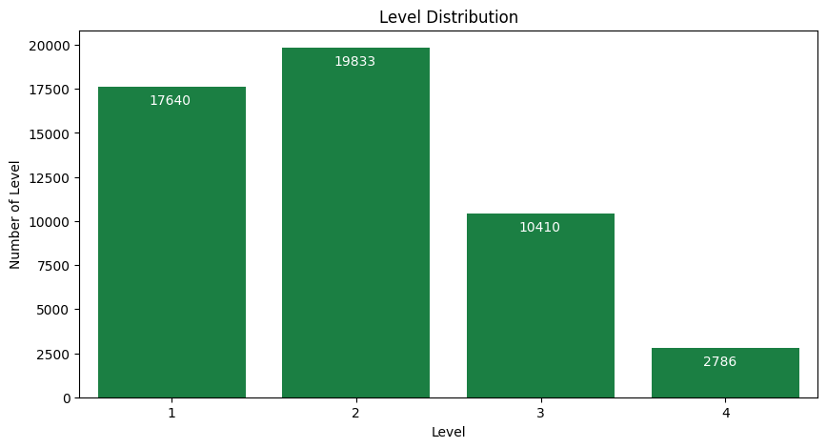
Street Level 2 Dominate the Dataset
With almost 20,000 records for level 2, and then followed by street level 1, 3, 4

Slide 5
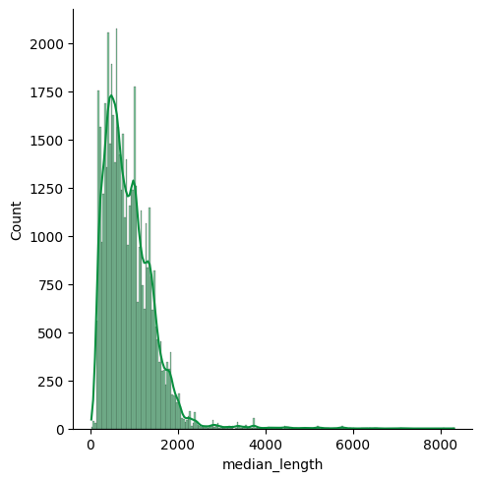
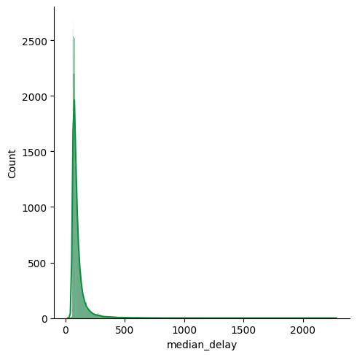
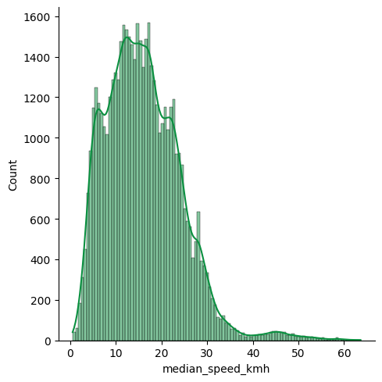
All Three Features Have Right Skewed Distribution
Median Speed have the most spread distribution than median length and median delay

Slide 6
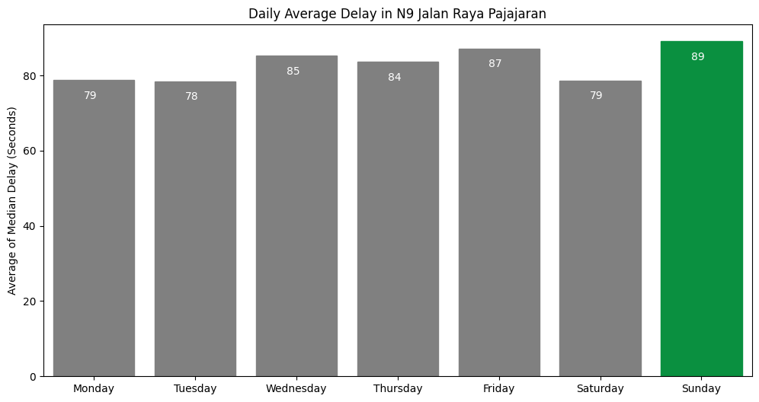
In The One Week, The Weekend of Sunday Has The Highest Delay
I use N9 Jalan Raya Pajajaran as a sample because it is have highest number of data records 1187.

Slide 7
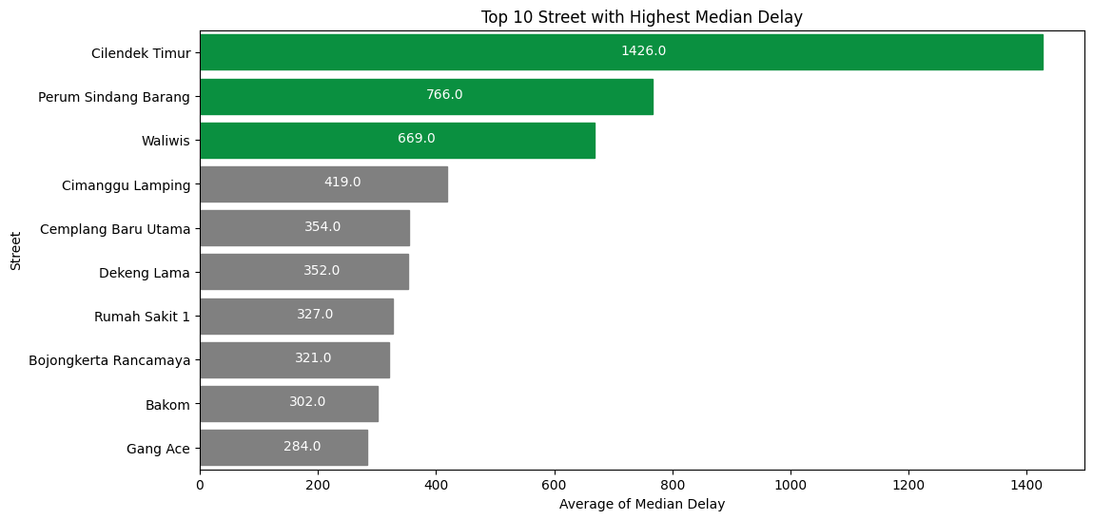
Top 10 Street With Highest Median Delay

Slide 8
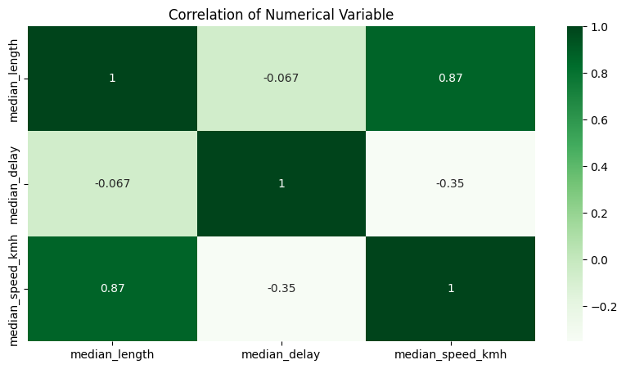
Numerical Variable Correlation Profile
Median Length ~ Median Delay = Weak
Median Length ~ Median Speed = Strong
Median Delay ~ Median Speed = Weak

Slide 9
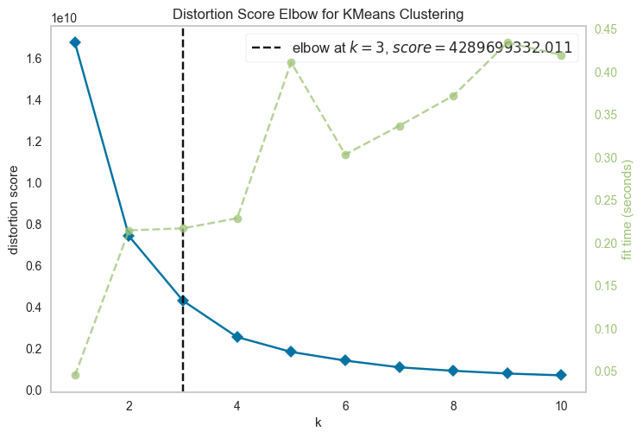
K = 3 is the best optimum clusters
Using distortion score I decide to use k = 3 as shown from K Elbow Visualizer

Slide 10
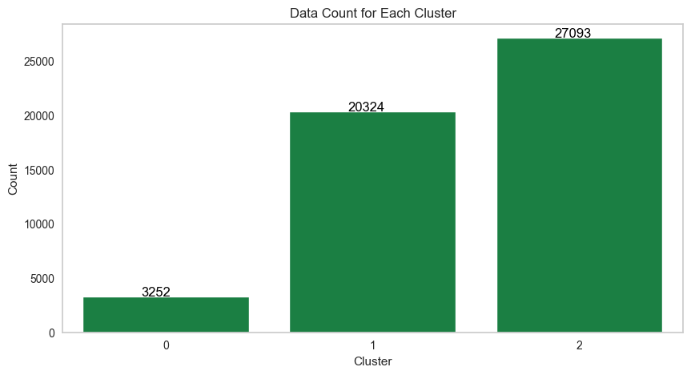
Cluster 2 Dominate The Number of Data Records

Slide 11
Cluster Profile
Cluster 0 and 2 have the dangerous impact and cluster 3 has the lowest danger impact
Cluster 0 : lower length, higher delay, lower speed
Cluster 1: moderate length, delay, and speed
Cluster 2: Similar with cluster 0 but have higher length and higher speed
Cluster 3: higher length, lower delay, high speed

Slide 12



Thank You
Contact me
ayubindra8@gmail.com
LinkedIn Profile
Github Link

